Slide 1
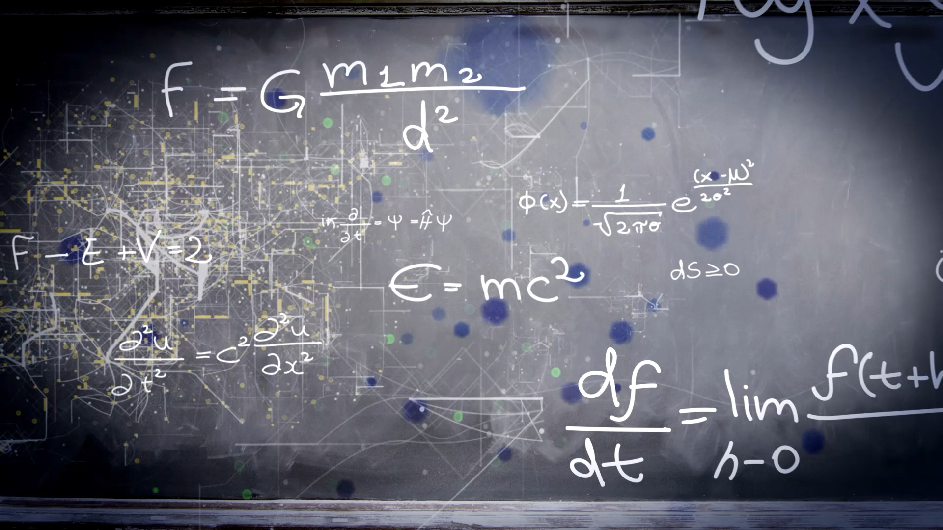
E-Course Platform Presentation

Slide 2

LAPR4 Group 1
Team members:
1960184 - João Silva
1050347 - Simão Gomes
1171159 - Filipe Teixeira
1222132 - Diogo Sousa

Slide 3
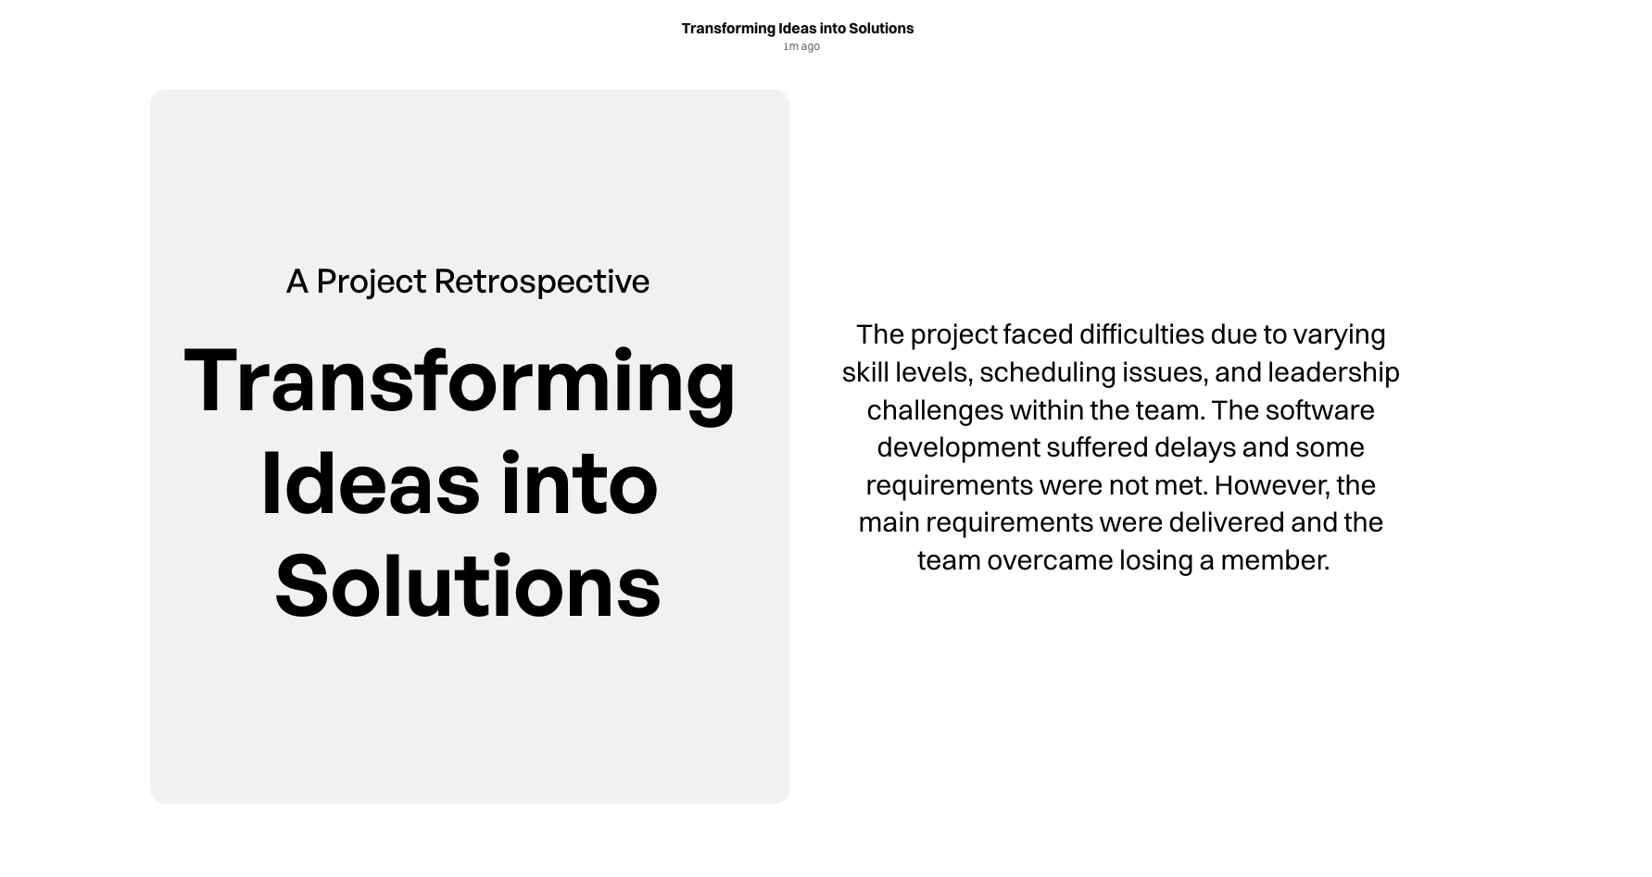

Slide 4
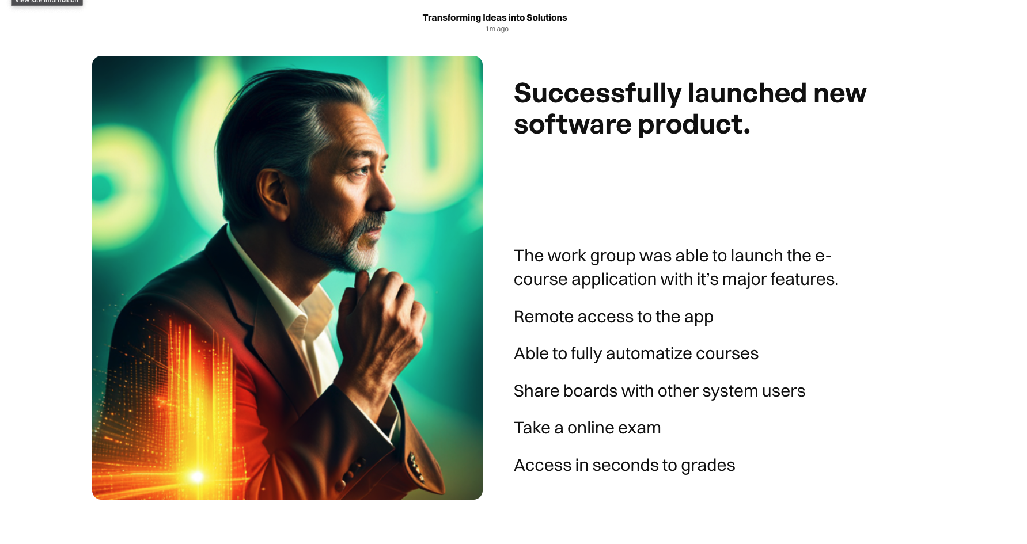

Slide 5
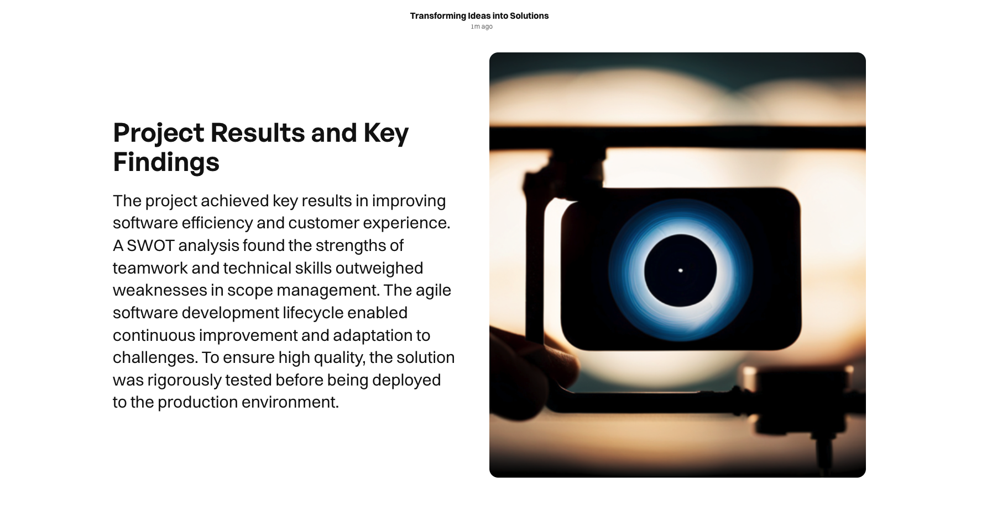

Slide 6
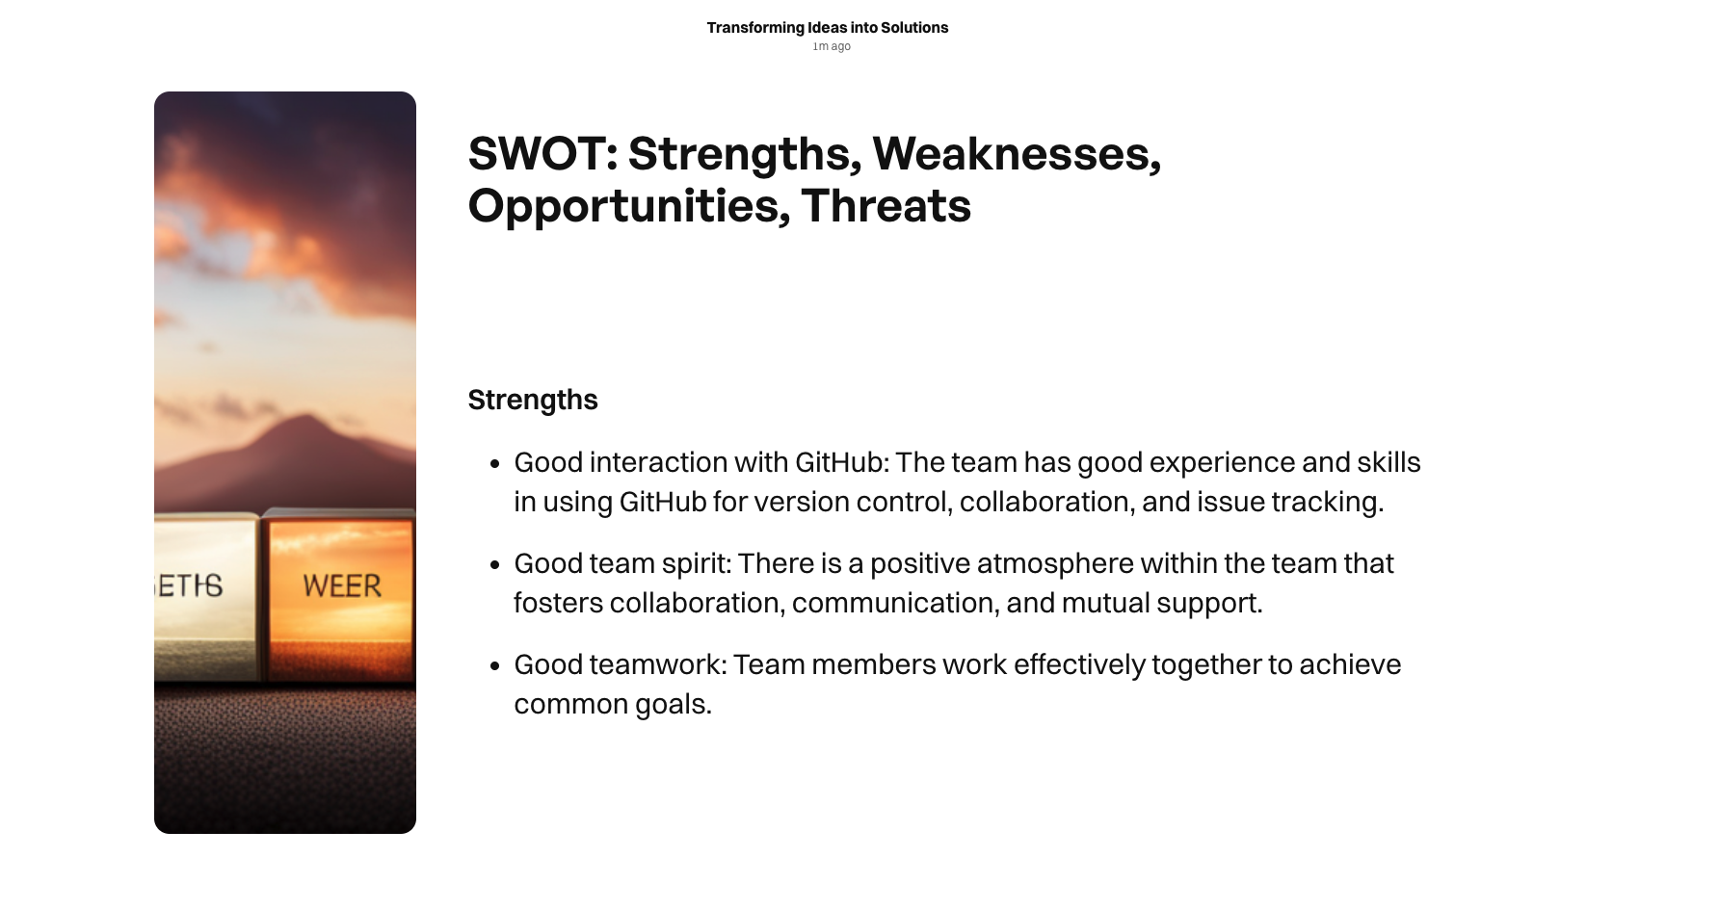

Slide 7
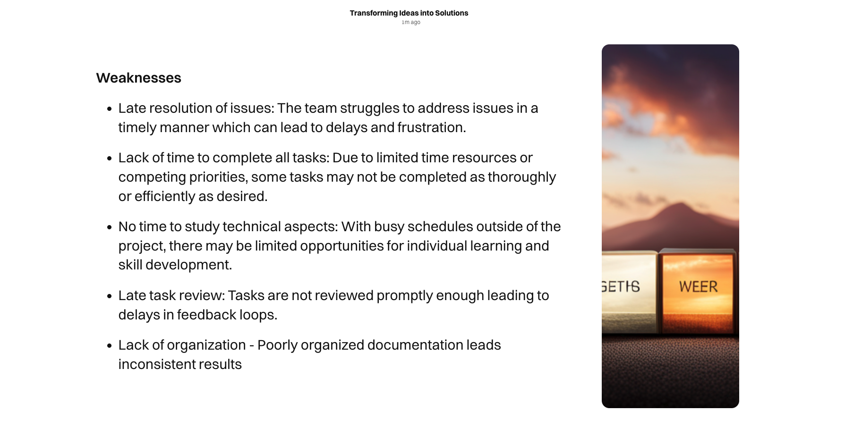

Slide 8
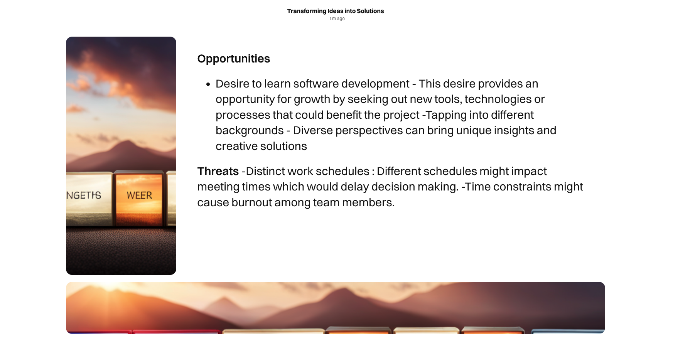

Slide 9
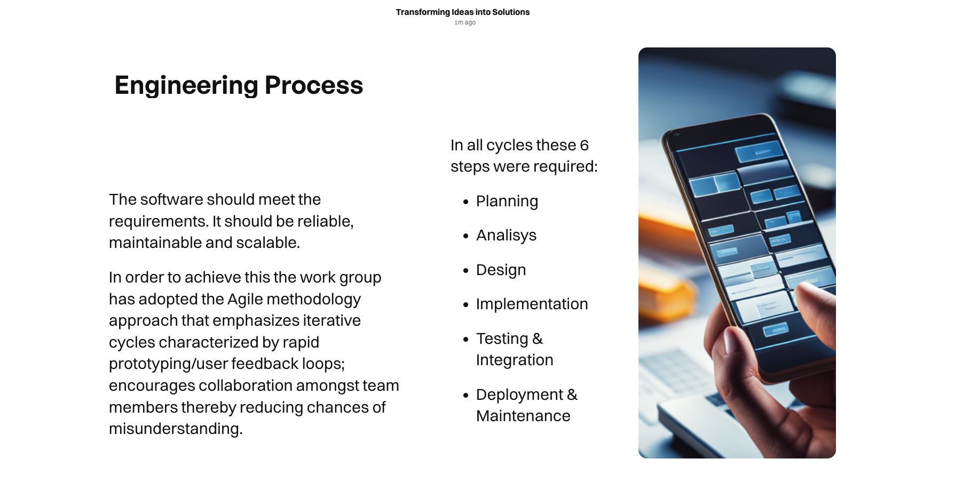

Slide 10
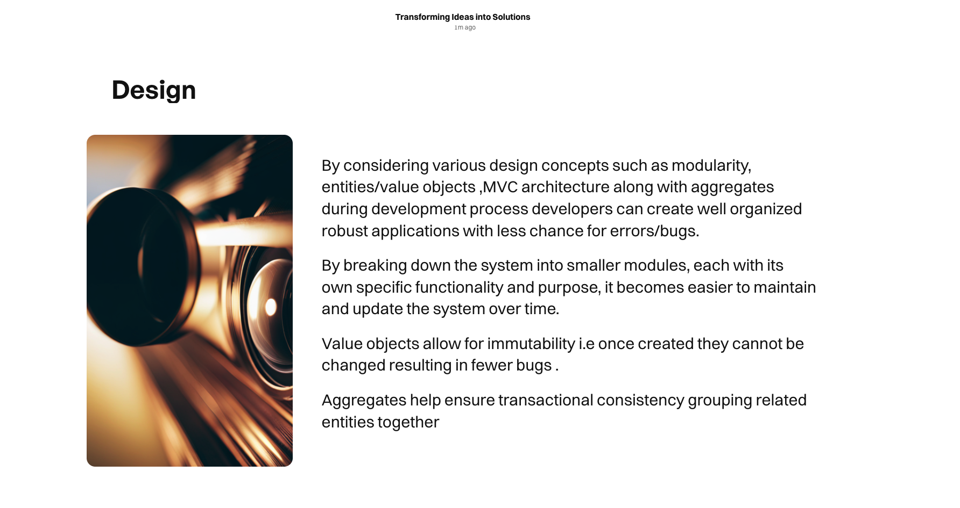

Slide 11


Slide 12
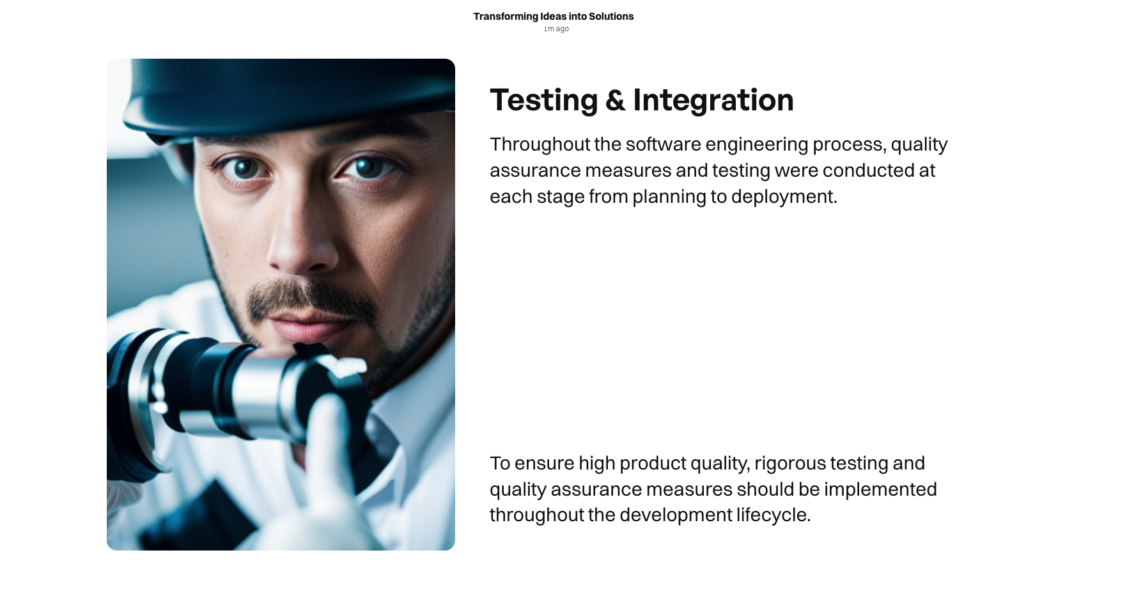

Slide 13


Slide 14


Slide 15
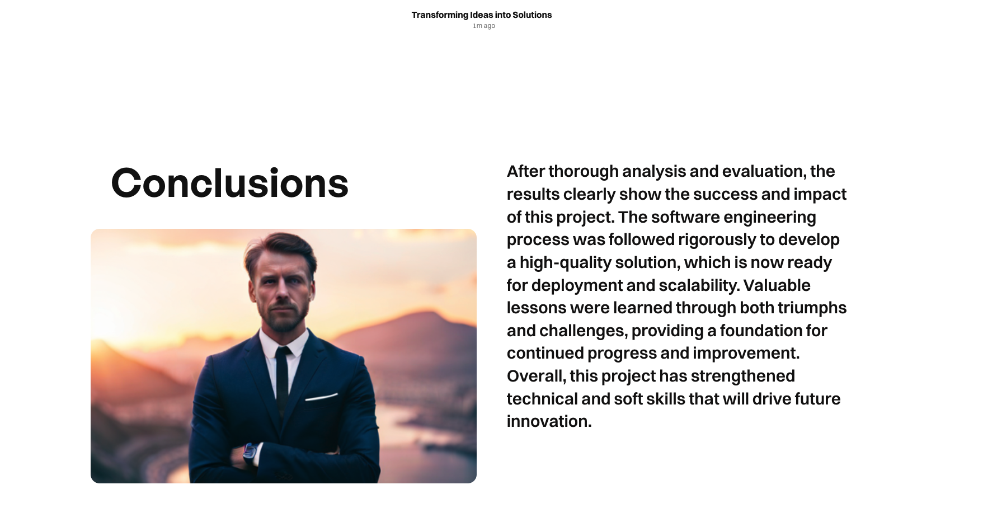

Slide 16


